Slide 1
Forecasting Volatility
In Stock Market
DATASCI 207 Final Project, March 27, 2026
Sid Sridhar – siddharthen_sridhar@berkeley.edu
Diogo Viveiros – diogoviveiros@berkeley.edu
Ronald Ho – ronald.ho@berkeley.edu
Vinit S. Bhatt – vbhatt@berkeley.edu

Slide 2
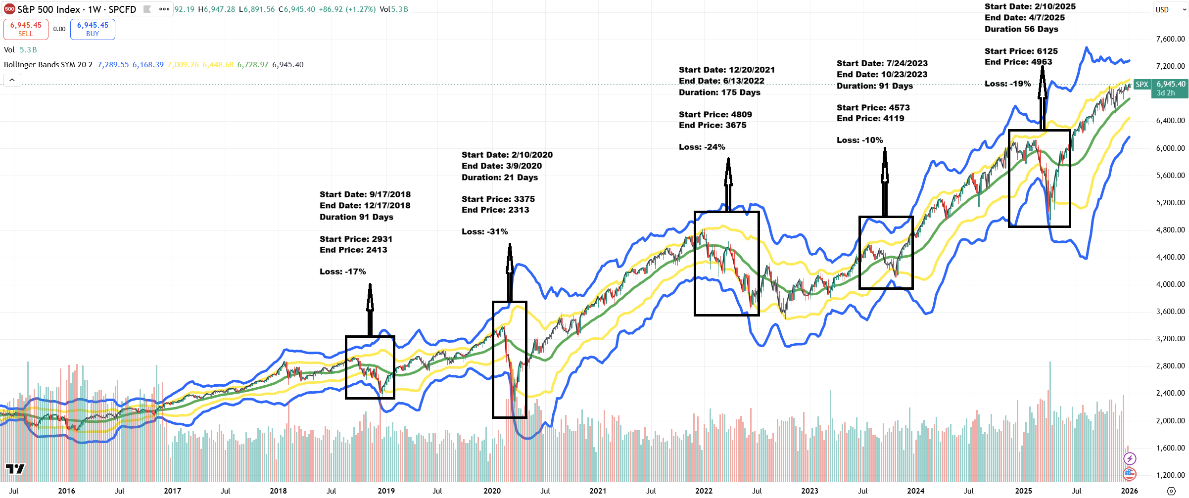
Project: Forecasting Volatility In Stock Market
What is Volatility?
S&P 500 chart highlighting major drawdowns and changing volatility regimes.
DATASCI 207 · Final Project: Forecasting Volatility In Stock Market · March 2026
Notes:
Project description summarized from the team project proposal and milestone report. [Sources] - Project Proposal PDF (uploaded in this chat) - Project Milestone Report PDF (uploaded in this chat) [/Sources]

Slide 3
Project: Forecasting Volatility In Stock Market
Project Scope, Universe & Model Lineup
Forecasting Objective
Predict next-week (next 5 trading days) realized volatility for S&P 500-linked ETFs using only information known at the prediction date.
Why it matters: volatility drives position sizing, risk budgeting, drawdown control, and derivatives/risk-management pricing.
Data Universe
36 ETF tickers:
S&P 500 market proxy,
sector ETFs,
industry ETFs.
6 macro/risk series for regime context:
3 month T-Bill yield
10 year US bond yield
US 10 year - month yield spread
Gold spot price
Oil spot price
VIX
Market (1): SPY
Sector (13): IYZ, VGT, XLB, XLC, XLE, XLF, XLI, XLK, XLP, XLRE, XLU, XLV, XLY
Industry (22): BEDZ, FTXG, KBE, KCE, KIE, KRE, PEJ, PNQI, PXQ, XAR, XBI, XES, XHB, XHE, XHS, XME, XOP, XPH, XSD, XSW, XTL, XTN
Prediction Models
Transformer 1: Diogo
Transformer 2: Ronald
LSTM: Sid
Elastic Net Regression: Vinit
DATASCI 207 · Final Project: Forecasting Volatility In Stock Market · March 2026
Notes:
Project description summarized from the team project proposal and milestone report. [Sources] - Project Proposal PDF (uploaded in this chat) - Project Milestone Report PDF (uploaded in this chat) [/Sources]

Slide 4
Dataset Description
Data Source: Downloads from FactSet
Observation & files
Coverage & universe
Core modeling fields
• 1 row = 1 instrument on 1 trading date
• Natural primary key: (ticker, date)
• Dates are trading dates, not calendar dates
• XLSX for review
• Convert XLSX to CSV
• 116,525 rows × 18 columns
• Date range: 2014-12-31 to 2025-12-31
• 42 total tickers = 36 ETFs + 6 macro/risk series
• ETF labels support market / sector / industry subgroup analysis
• Price/volume: adjusted close, volume
• Volatility: trailing 5 day and 20 day
• Target: forward 5 day volatility
• Groups: market, sector, industry
How the data is stored
Long-format source table: all ETFs and the 6 macro/risk series are stacked in one table keyed by (ticker, date).
1. Filter 6 macro tickers
2. Pivot long → wide by date
3. Left-join onto ETF panel
4. Modeling-ready panel
Key modeling convention
trailing features end at time t, while the prediction target is next-week realized volatility over t+1 to t+5.
This preserves a strict no-look-ahead design.
DATASCI 207 · Final Project: Forecasting Volatility In Stock Market · March 2026
Notes:
[Sources] - Uploaded PDF: volatility_dataset_description_UPDATED_013026.pdf (dataset size, schema, key, target, macro storage, join strategy) - Uploaded PPTX: project slide deck used as style reference [/Sources]

Slide 5
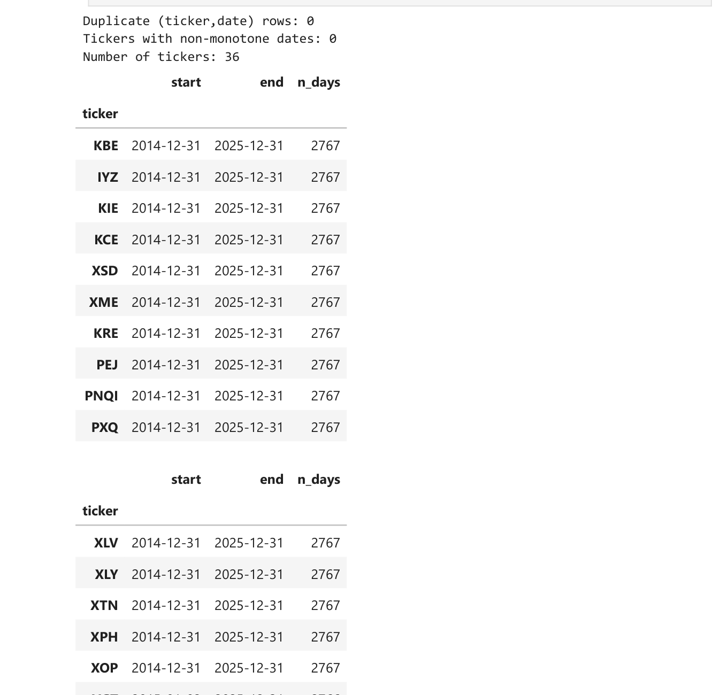
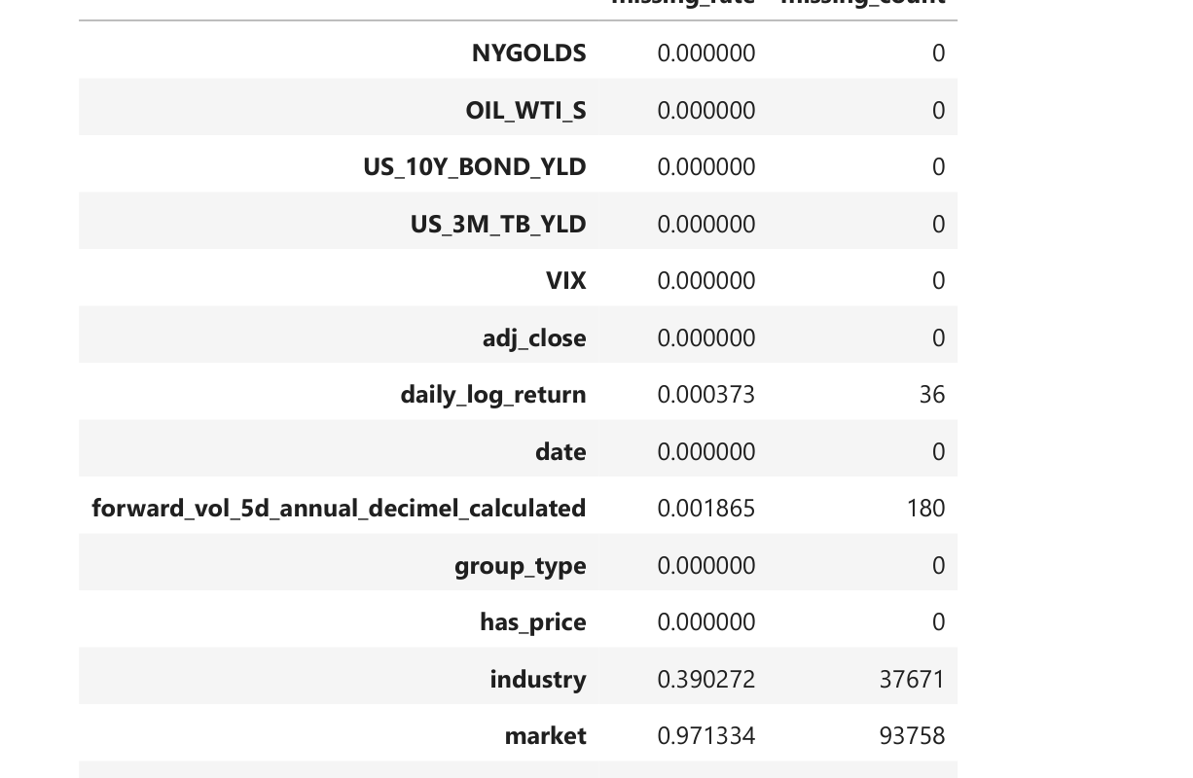
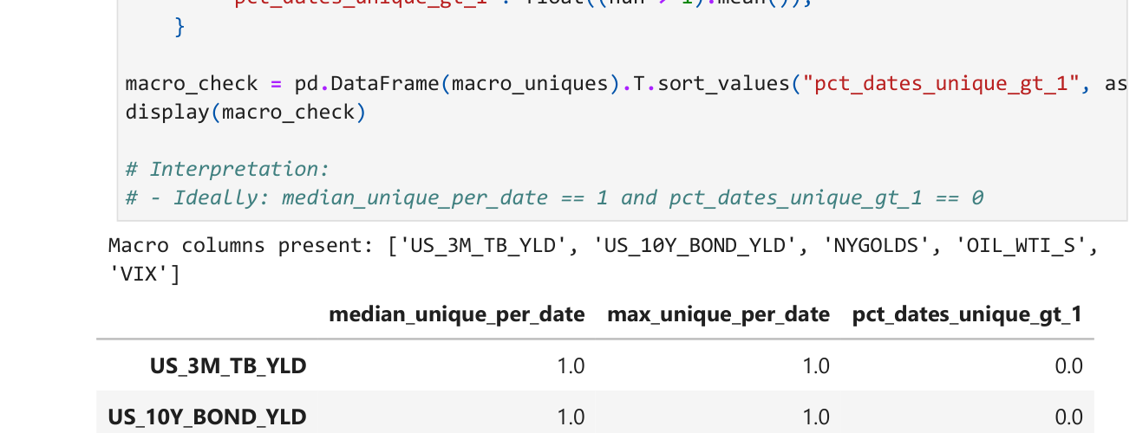
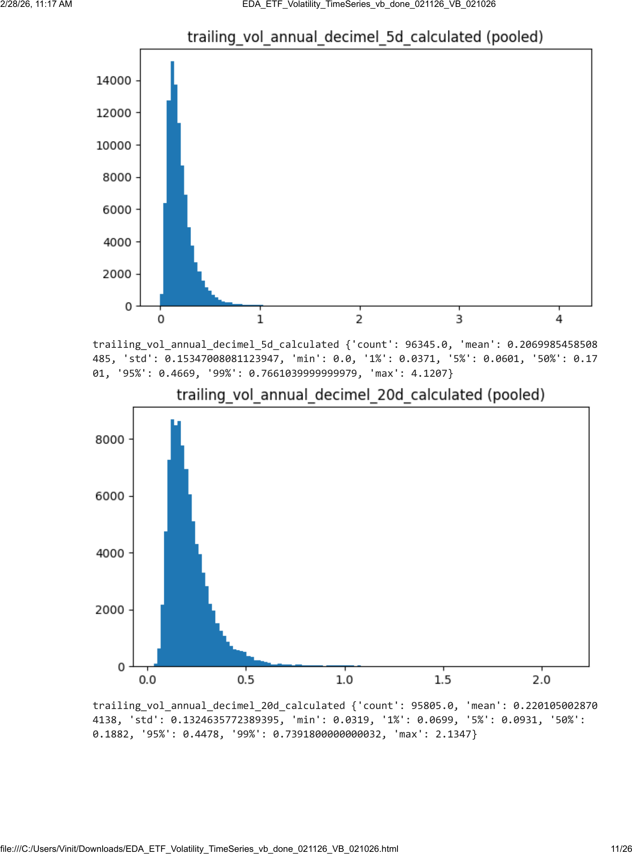
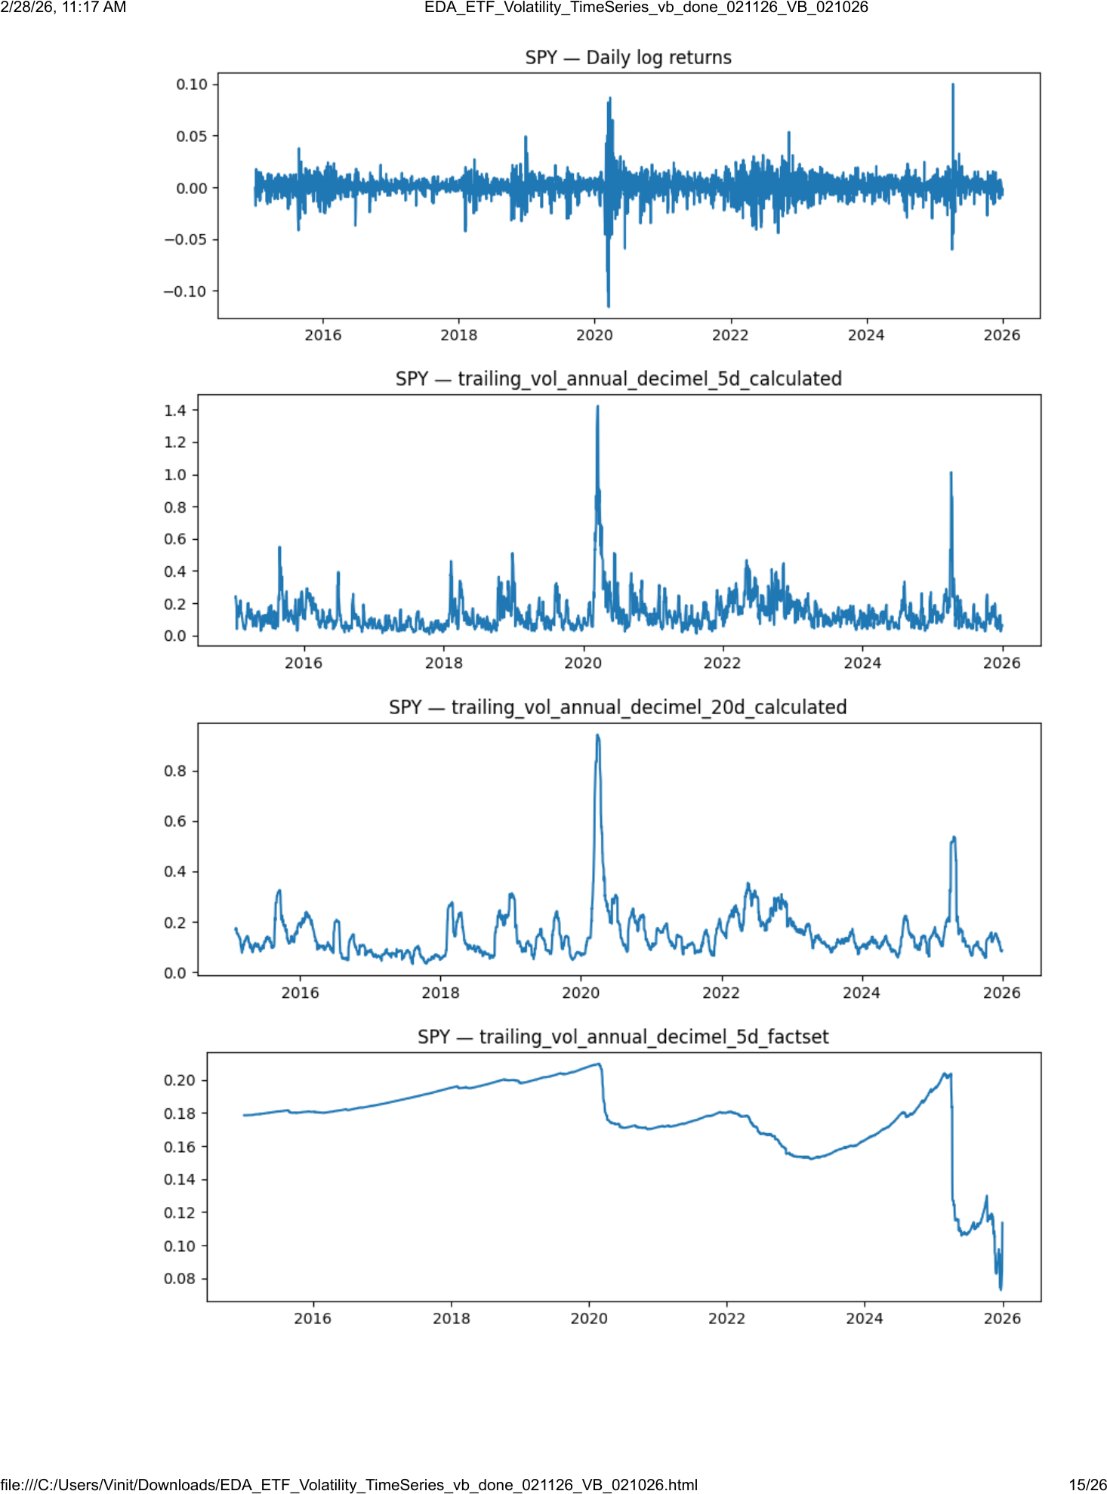
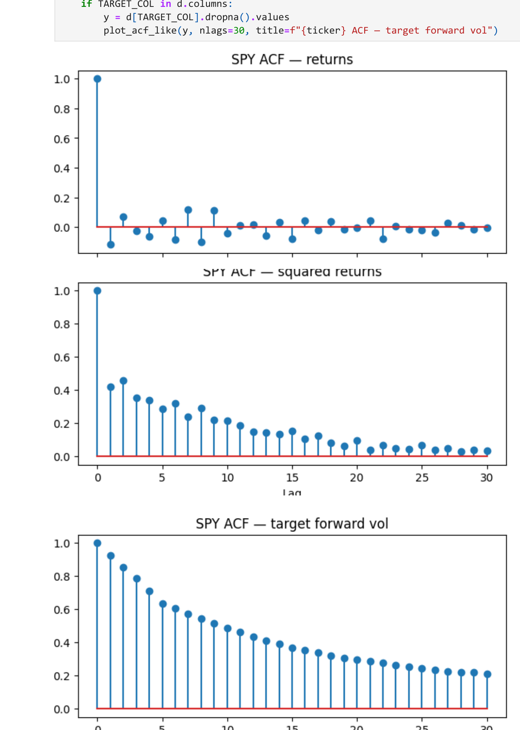
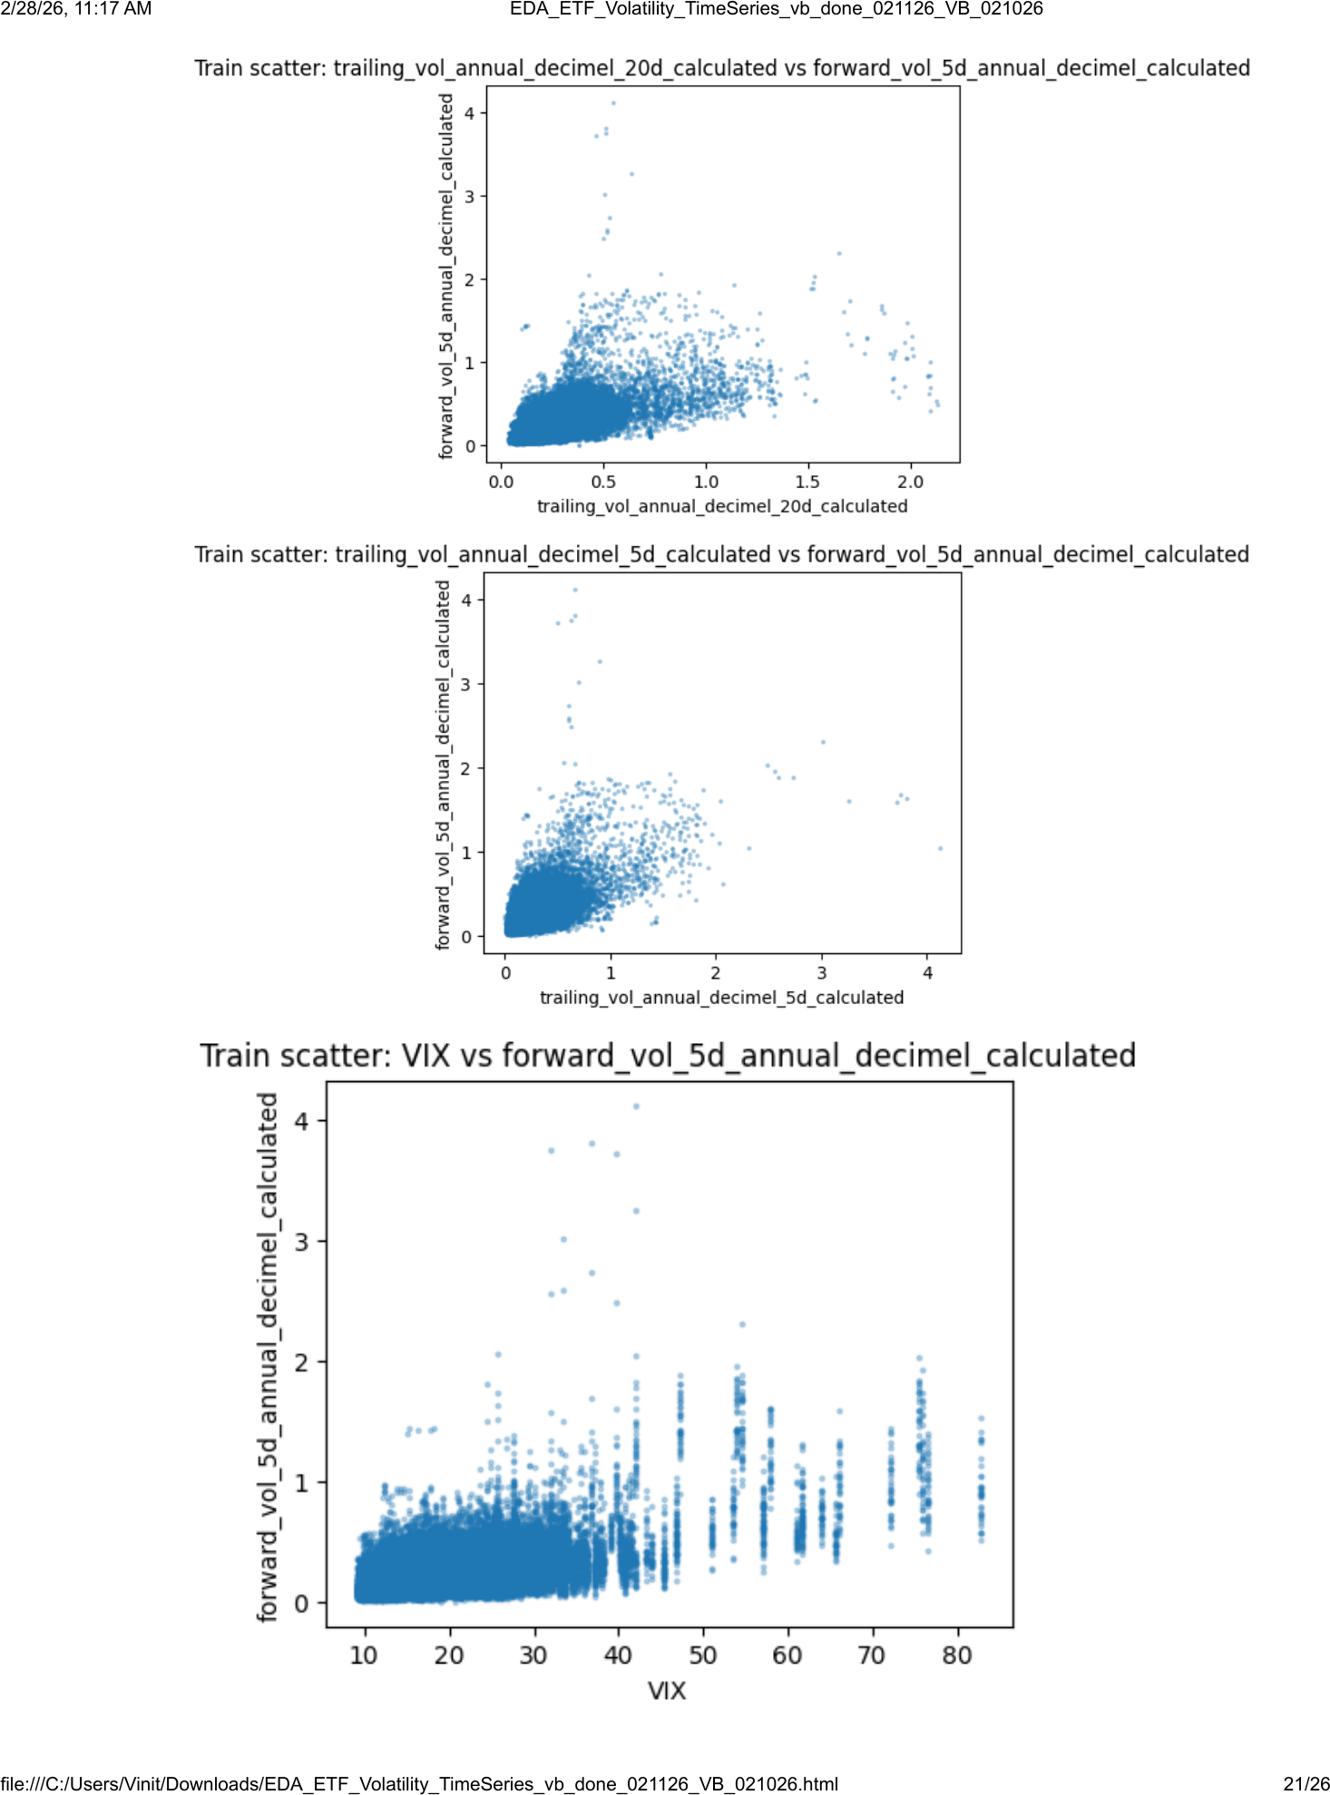
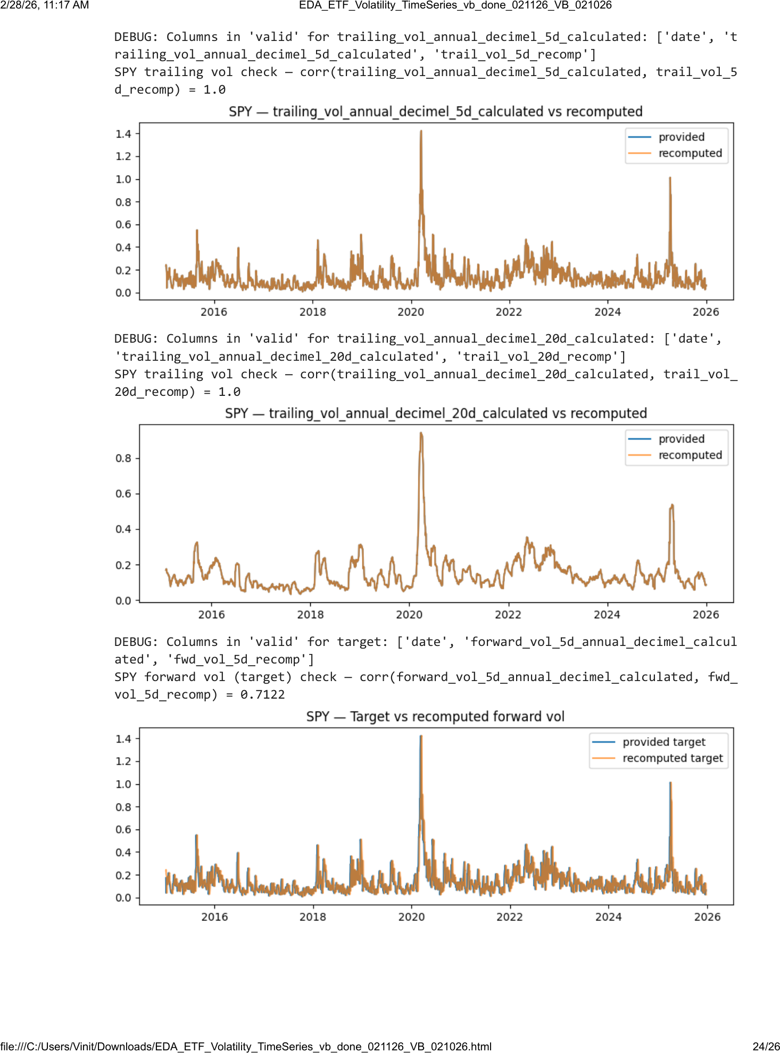
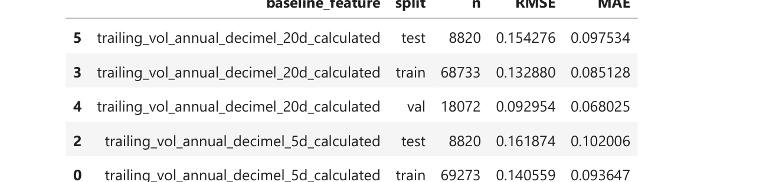
EDA
EDA Tests
Outputs & Plots
All EDA tests/checks performed
Representative plots produced by the notebook
1) Load + robust date parse + canonical (ticker, date) sort
2) Panel integrity: duplicate key check; per-ticker monotone dates
3) Coverage: per-ticker start/end and n_days table
4) Gaps: flag calendar gaps > 10 days within ticker
5) Missingness: by-column rates + target missingness by ticker
6) Macro sanity: macro columns constant across tickers per date (nunique)
7) Distribution EDA: returns, log(volume), trailing vol (calc + FactSet), target
8) Single-ticker series: price, returns, trailing vol, target + macro overlays
9) ACF diagnostics: returns vs squared returns vs target forward vol
10) Feature–target checks: train-only corr table + scatter plots
11) Leakage/alignment: recompute returns, trailing vol, forward vol; compare
12) Baselines: persistence using trailing 5d/20d vol (RMSE/MAE on train/val/test)
13) Save artifacts: coverage/missingness/macro-check tables to disk
Data quality
Coverage by ticker
Gaps & missingness
Macro constancy check
Time-series structure
Pooled distributions (returns/volume/vol)
Single-ticker
ACF diagnostics returns, sq. returns,
Signal, leakage checks, baselines
Feature–target relationships (corr + scatter)
Leakage/alignment checks
Baselines to beat
DATASCI 207 · Final Project: Forecasting Volatility In Stock Market · March 2026
Notes:
[Sources] - Uploaded PDF: DATASCI 207 — ETF Volatility Dataset: Time-Series EDA (EDA_ETF_Volatility_TimeSeries_vb_done_021126_VB_021026) — used for the checklist text and plot thumbnails. - Uploaded PPTX: project slide deck (style reference for header/footer and typography). [/Sources]

Slide 6
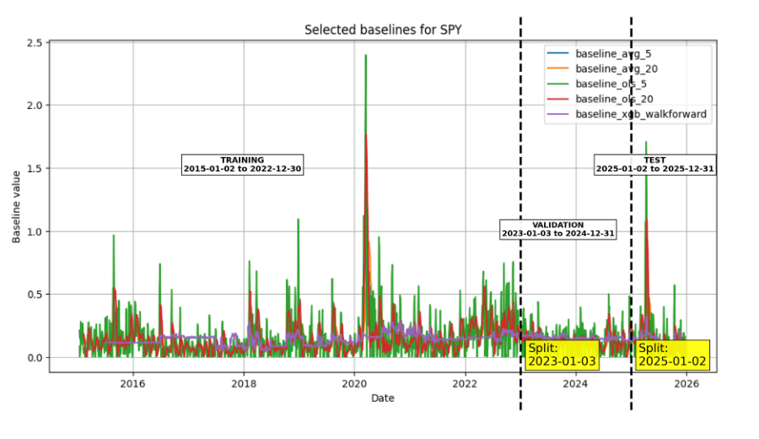
Data Splitting
Split is Chronological, Leakage-Aware, and Standardized Across All Team Models
Training
Validation
Test
Leakage control
2015-01-02 → 2022-12-30 69,453 rows | 71.95% Long historical window for model fitting
2023-01-03 → 2024-12-31 18,072 rows | 18.72% Recent window for tuning and model selection
2025-01-02 → 2025-12-31 9,000 rows | 9.32% Fully held-out year for final evaluation
5-trading-day purge gap at each boundary Remove rows whose target window crosses partitions
Methodology & guardrails
Chronological split visualization
• Split by date across all ETFs simultaneously; no random shuffling.
• Forward 5-day target uses future returns, so chronology must be preserved.
• Same train / validation / test rows used for every team model.
• Natural year boundaries create realistic validation and unseen test periods.
Checks passed: train max < validation min, validation max < test min, no overlap, all rows accounted for.
DATASCI 207 · Final Project: Forecasting Volatility In Stock Market · March 2026

Slide 7
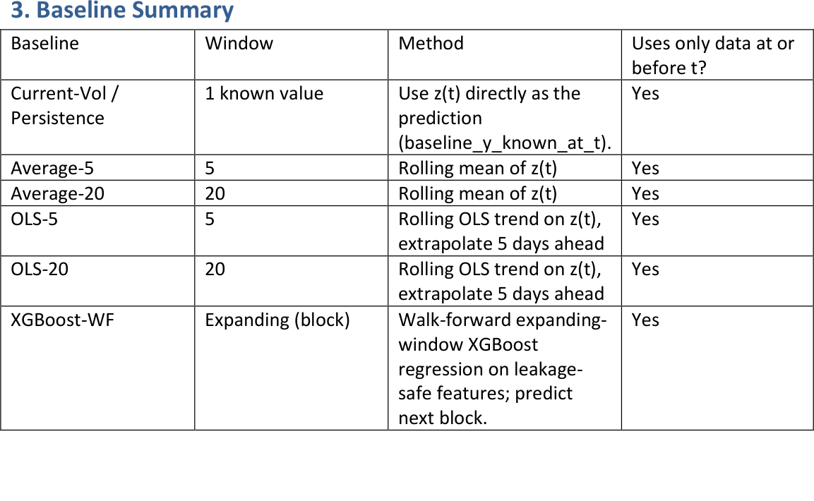
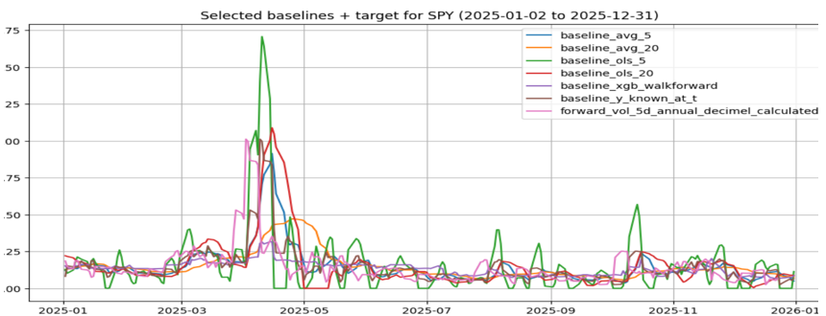
Baselines
6 Baseline Leakage-Safe
Six baseline models
Example: SPY baselines vs target (2025)
Note: plot overlays 6 baseline predictions with the target forward 5-day volatility.
DATASCI 207 · Final Project: Forecasting Volatility In Stock Market · March 2026

Slide 8
Elastic Net Regression
DS 207 Final Project · Team: Greed and Fear · Author: Vinit Bhatt · March 27, 2026

Slide 9
What Is Elastic Net?
How It Works
Elastic Net is a linear regression model with built-in regularization. It helps the model fit the data while avoiding noisy or unstable coefficients.
Think of it as a combination of two ideas:
Lasso (L1): removes weak or redundant features
Ridge (L2): shrinks and stabilizes correlated features
Elastic Net: does both at the same time
Why We Use It Here
Our volatility features overlap
Some macro variables may add little value
We want a model that is still easy to interpret
Bottom Line
Elastic Net is a strong, interpretable benchmark that helps us identify which features matter and which do not.
Main Tradeoff
Elastic Net is transparent and disciplined
But it is still linear, so it may miss nonlinear volatility patterns
DATASCI 207 · Final Project: Forecasting Volatility In Stock Market · March 2026

Slide 10
Elastic Net Setup: V1 vs. V2
V2 tests whether macro and market context improves on the simple volatility-only V1 model
Model Tier | Features | Count | Role / Notes
V1 — Current-State Volatility | Current realized volatility (most recent observation) 20-day trailing realized volatility | 2 | Pure vol-persistence model. Both features genuinely retained by Lasso.
V2 — Added Macro/Market | + Volume + NYGOLDS + OIL_WTI_S + US_10Y_BOND_YLD + US_3M_TB_YLD + VIX | 8 | Current-state macro context. Only VIX survives Lasso regularization. Other 5 macro features zeroed out.
DATASCI 207 · Final Project: Forecasting Volatility In Stock Market · March 2026

Slide 11
Model Performance Results — 2025 Test Set (8,820 rows)
All results use the same 8,820-row test set. Lower MAE and RMSE are better; higher R² is better.
Key takeaway: V2 is the strongest Elastic Net model, but XGBoost remains the benchmark to beat on test MAE.
Model / Baseline | Candidate Features | Retained | Test MAE | Test RMSE | Test R² | vs XGBoost
V1 — Elastic Net | 2 | 2 | 0.0855 | 0.1357 | 0.1794 | +0.0032
V2 — Elastic Net | 8 | 3 | 0.0846 | 0.1324 | 0.2188 | +0.0024
Baseline: XGBoost walk-forward | — | — | 0.0823 | 0.1352 | 0.1856 | BEST ★
Baseline: Trailing 20 Day Average | — | — | 0.0922 | 0.1491 | 0.0088 | +0.0099
Baseline: Trailing 5 Day Average | — | — | 0.1005 | 0.1625 | −0.1773 | +0.0182
Baseline: Current Volatility | — | — | 0.1020 | 0.1619 | −0.1680 | +0.0197
Baseline: Trailing 20 Day OLS | — | — | 0.1298 | 0.2091 | −0.9498 | +0.0475
Baseline: Trailing 5 Day OLS | — | — | 0.1644 | 0.2478 | −1.7383 | +0.0821
DATASCI 207 · Final Project: Forecasting Volatility In Stock Market · March 2026

Slide 12
Interpretation: What Elastic Net Retained
V1 retains two current-state volatility features.
20-day trailing volatility term is the stronger predictor.
V2 adds six macro and market features.
Only VIX is retained; the others are shrunk to zero.
V1 retained features (2/2)
V2 retained features (3/8)
Feature
Coeff
Meaning
Feature
Coeff
Meaning
20-day trailing vol
+0.0487
Dominant, smoother persistence signal
20-day trailing vol
+0.0405
Still dominant; slightly smaller with VIX added
Current vol
+0.0377
Recency beyond the 20-day average
Current vol
+0.0323
Recency remains informative
VIX
+0.0293
Forward-looking implied volatility signal
V1 Economic Meaning: Volatility
Both coefficients are positive
20-day trailing volatility is the stronger signal
Current volatility recency
V2: Why VIX Survives
VIX forward-looking, while the other retained volatility measures are backward-looking.
That gives VIX unique predictive value in V2.
DATASCI 207 · Final Project: Forecasting Volatility In Stock Market · March 2026
Notes:
Coefficient interpretation for V1 and V2 (Elastic Net). [Sources] - elastic_net_vol_v1v2_vb_done_032726.ipynb (user-provided notebook) - elastic_net_vol_slides_wip_032726.pptx (user-provided deck)

Slide 13
Subgroup Breakdown: Market / Sector / Industry ETFs
Performance by ETF subgroup. Industry ETFs are hardest to forecast because idiosyncratic risk is less well captured by aggregate volatility signals. V2’s clearest MAE improvement appears at the industry level.
Group | N Rows | V1 MAE | V2 MAE | V1 RMSE | V2 RMSE | V1 R² | V2 R² | ΔMAE (V2 – V1)
Market ETF | 245 | 0.0792 | 0.0802 | 0.1264 | 0.1225 | 0.1442 | 0.1973 | +0.0010
Sector ETF | 3,185 | 0.0737 | 0.0743 | 0.1148 | 0.1123 | 0.1410 | 0.1774 | +0.0006
Industry ETF | 5,390 | 0.0927 | 0.0910 | 0.1470 | 0.1433 | 0.1367 | 0.1796 | −0.0017
Note: Negative ΔMAE is better.
Key takeaway: V2 improves R² in all subgroups, but lowers MAE only for industry ETFs.
DATASCI 207 · Final Project: Forecasting Volatility In Stock Market · March 2026

Slide 14
Conclusions
Key Conclusions
V1 showed that current-state volatility features carry real predictive signal.
V2 improved on V1 modestly, and most of that improvement came from VIX.
V2 was the best Elastic Net model, but XGBoost remained the strongest benchmark on test MAE.
All retained coefficients were positive, consistent with volatility clustering and persistence.
Overall, Elastic Net provided a transparent and interpretable benchmark for the project.
DATASCI 207 · Final Project: Forecasting Volatility In Stock Market · March 2026

Slide 15
Long Short-Term Memory (LSTM)
DS 207 Final Project · Team: Greed and Fear · Author: Sid Sridhar · March 27, 2026

Slide 16
Title
Heading
Bullet.
Bullet.
Bullet.
Bullet.
Bullet.
DATASCI 207 · Final Project: Forecasting Volatility In Stock Market · March 2026

Slide 17
Transformer
DS 207 Final Project · Team: Greed and Fear · Author: Ronald Ho · March 27, 2026

Slide 18
Title
Heading
Bullet.
Bullet.
Bullet.
Bullet.
Bullet.
DATASCI 207 · Final Project: Forecasting Volatility In Stock Market · March 2026

Slide 19
Transformer Architecture
Input
Input
Dropout
Multi-Head Attention
Transformer Encoding Block
Dropout
(…) * num_blocks
Layer Normalization
Transformer Encoding Block
Residual Connection
Flatten
Output (Dense)
Dropout
Dropout
Residual Connection
Output (Dense)
Layer Normalization
DATASCI 207 · Final Project: Forecasting Volatility In Stock Market · March 2026

Slide 20
Hyper-Parameter Considerations
Dropout / Masking Layers
# Epochs
Block Count
Head Size
FFN Dimension
Keep number of blocks low (2-4)
Why: Each block will allow the transformer to memorize something different about the data. This can quickly lead to overfitting with such a simple dataset.
Set a sequence length of ~21.
Why: The sequence length determines how many rows (data) the model will keep in its memory when running the Attention Layer. The variable with the longest backward-looking period is 20 days.
Randomly deactivating weights while training the model to avoid overfitting.
Why: Transformers are the most complex mainstream models due to their ability to memorize data so well. This can quickly lead to overfitting, so forcing it to not rely on patterns when training is extremely important.
Increasing dimensionality in transformer block before applying ReLU.
Why: Expanding the dimensions by a significant amount allows us to find greater non-linear relationships with the ReLU function.
High Epoch limit (100 to 200) with Early Stopping Callbacks.
Why: Transformers are computationally expensive and slow to learn. Setting a high epoch number with a callback allows us to maximize performance without overfitting.
DATASCI 207 · Final Project: Forecasting Volatility In Stock Market · March 2026
Notes:
Building a transformer requires a lot of specific choices to optimize the hyperparameters in the architecture. Due to its high memorization ability, we should keep the number of encoder blocks simple, approximately 2 to 4. Any more than that and we see a large amount of overfitting. This is paired with the Dropout (or Mask Padding in Ronald’s model), making our model ignore random weights in order to force the model to generalize well, not just memorize all of the data it sees.
Within the Encoder, we must make decisions on the Sequence length, Head Size, and the Feed Forward dimension. The Sequence Length determines how many days of history we look at (since one of our V2 variables looks at the past 20 days, I set this length to 21). Choosing Epochs is tricky: Transformers learn slowly but are also extremely consuming per epoch to calculate. We have to set a high epoch limit and let them train over a lengthened period of time, and rely on Early Stopping to check when our performance plateaus.

Slide 21
Model Comparisons — 2025 Test Set (8,820 rows)
All results use the same 8,820-row test set. Lower MAE and RMSE are better; higher R² is better.
Model / Baseline | Test MAE | Test RMSE | Test R² | vs XGBoost
Elastic Net — V1 | 0.0855 | 0.1357 | 0.1794 | +0.0032
Elastic Net — V2 | 0.0846 | 0.1324 | 0.2188 | +0.0024
LSTM— V1
LSTM— V2
Transformer-Encoder Only— V1
Transformer-Encoder Only— V2
Transformer-Encoder (Diogo) – V1
Transformer-Encoder (Diogo) – V2 | 0.1034 | 0.1503 | 0.0425 | +0.0211
Baseline: XGBoost walk-forward | 0.0823 | 0.1352 | 0.1856 | BEST ★
Baseline: Trailing 20 Day Average | 0.0922 | 0.1491 | 0.0088 | +0.0099
Baseline: Trailing 5 Day Average | 0.1005 | 0.1625 | −0.1773 | +0.0182
Baseline: Current Volatility | 0.1020 | 0.1619 | −0.1680 | +0.0197
Baseline: Trailing 20 Day OLS | 0.1298 | 0.2091 | −0.9498 | +0.0475
Baseline: Trailing 5 Day OLS | 0.1644 | 0.2478 | −1.7383 | +0.0821
DATASCI 207 · Final Project: Forecasting Volatility In Stock Market · March 2026

Slide 22

DATASCI 207 · Final Project: Forecasting Volatility In Stock Market · March 2026

